Slide 1

Cutting burdensome Rules in Missouri

Slide 2
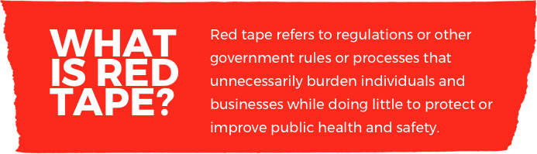
Defining red tape

Slide 3

Ways to measure red tape
Number of regulations
Number of words
Number of pages
Number of restrictions
“shall,” “must,” “may not,” “prohibited,” and “required”

Slide 4
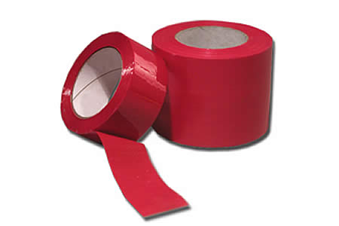
Comparing red tape measurements
Number of regulations
DED has 176 regulations = 7,384 restrictions
DNR has 139 regulations = 24,370 restrictions
Number of words
466 regulations have 182,889 words = 0 restrictions
Two DNR regulations have 167,595 words = 4,215 restrictions
Source: State Administrative Codes – Missouri, http://quantgov.org/data

Slide 5

Missouri has Too much red tape
113,112 regulatory restrictions
7.5 million words
More than 400 hours of reading
More than 40,000 pages in the Missouri Register since 2000
Sources: Mercatus Center, “A Snapshot of Missouri Regulation in 2017,” available at https://www.mercatus.org/publications/snapshot-missouri-regulation; Missouri Register.

Slide 6
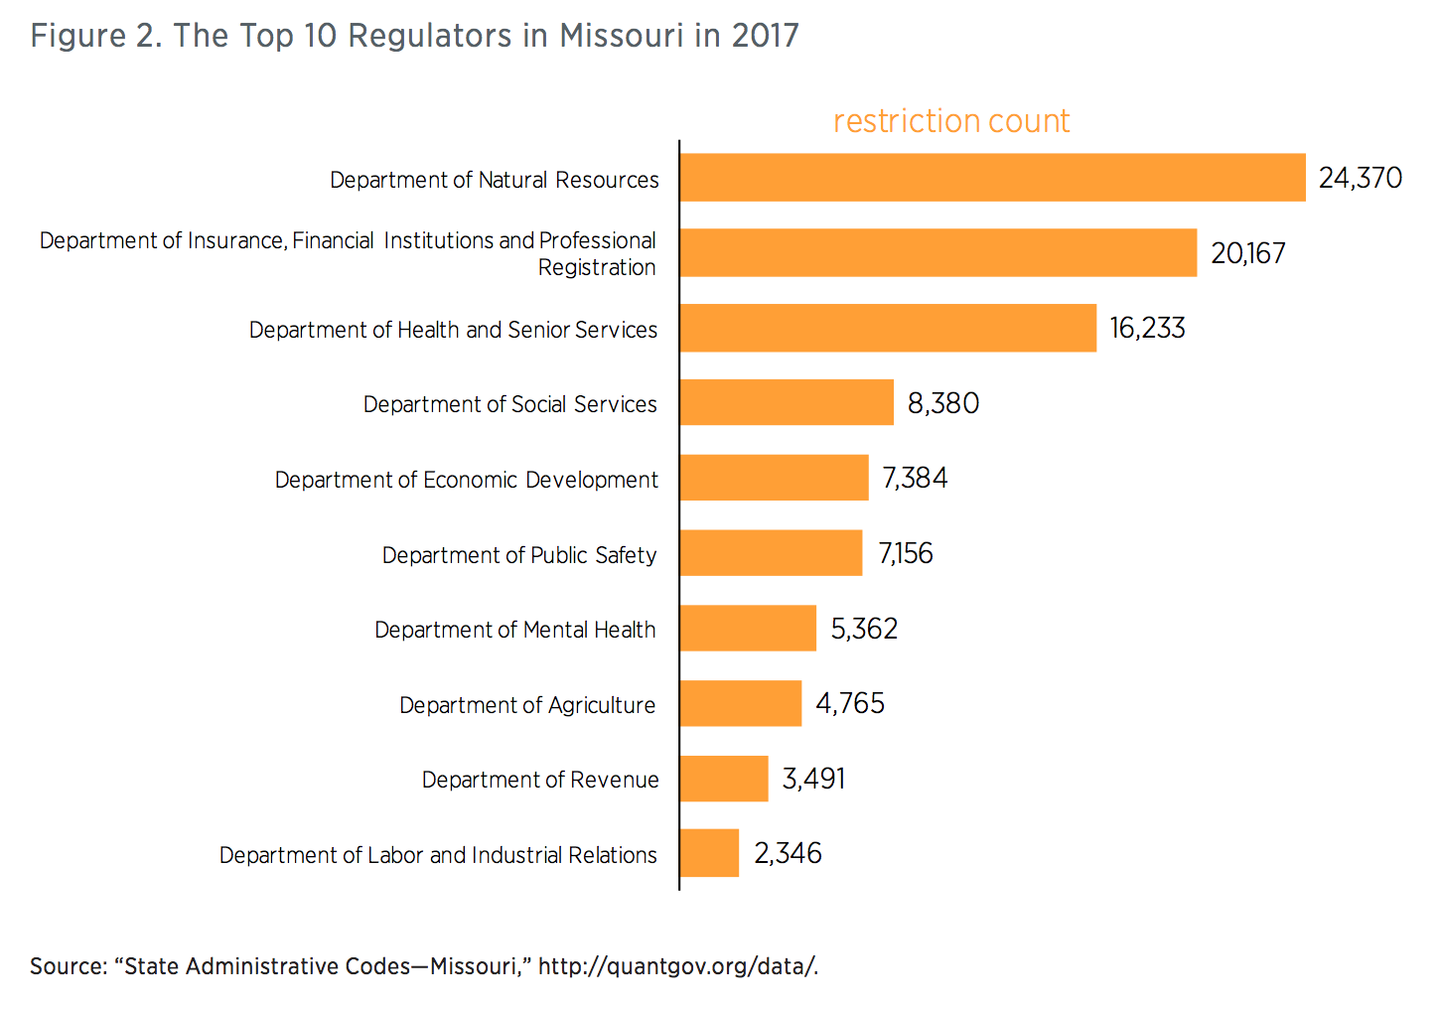
Top 10 Regulatory Agencies in Missouri

Slide 7
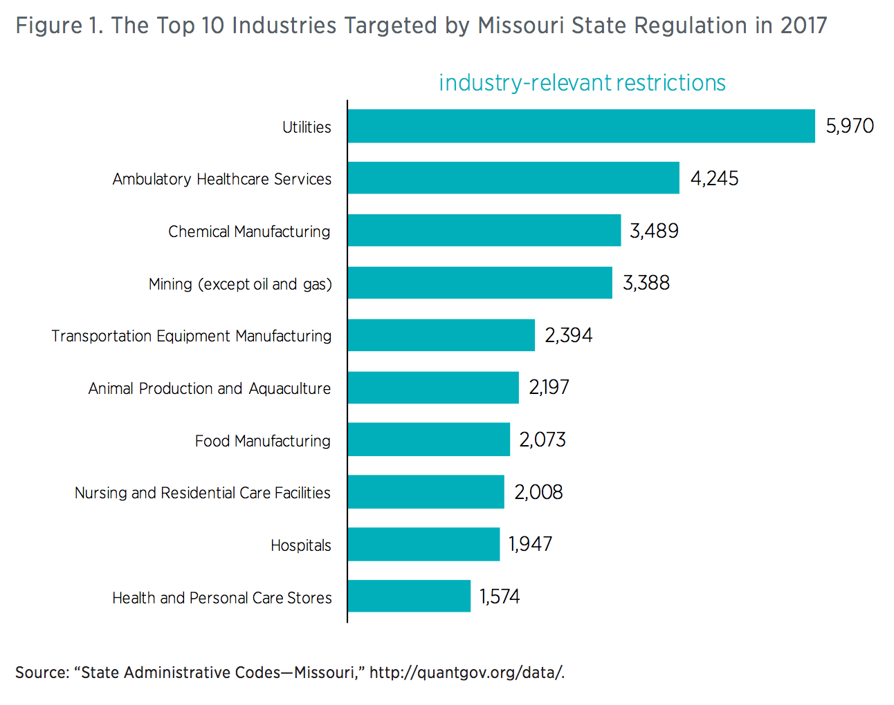
Top 10 targeted industries in Missouri

Slide 8
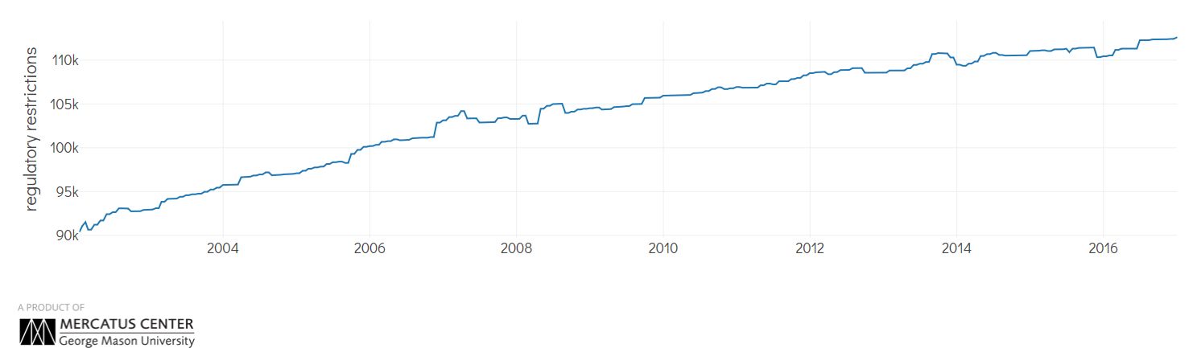
The Rise of Red Tape in Missouri

Slide 9
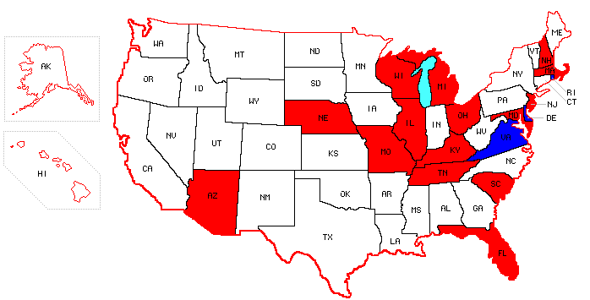
Other Government Regulatory Reviews
Arizona (2015, Ducey)
Delaware (2013, Markell)
Florida (2011, Scott)
Illinois (2016, Rauner)
Kentucky (2016, Bevin)
Maryland (2015, Hogan)
Massachusetts (2015, Baker)
Michigan (2011, Snyder)
Missouri (2017, Greitens)
Nebraska (2017, Ricketts)
New Hampshire (2017, Sununu)
New Jersey (2010, Christie)
Ohio (2011, Kasich)
Rhode Island (2014, Chafee & 2015, Raimondo)
South Carolina (2013, Haley)
Tennessee (2011, Haslam)
Virginia (2013, McDonnell & 2014, McAuliffe)
Wisconsin (2013, Walker)

Slide 10
Public Comments – Other States

Slide 11
Regulatory Repeal – other states

Slide 12

The Missouri approach
Issued Executive Order 17-03
Assembled Red Tape Cutters
Launched NoMORedTape.com
Cutting red tape

Slide 13
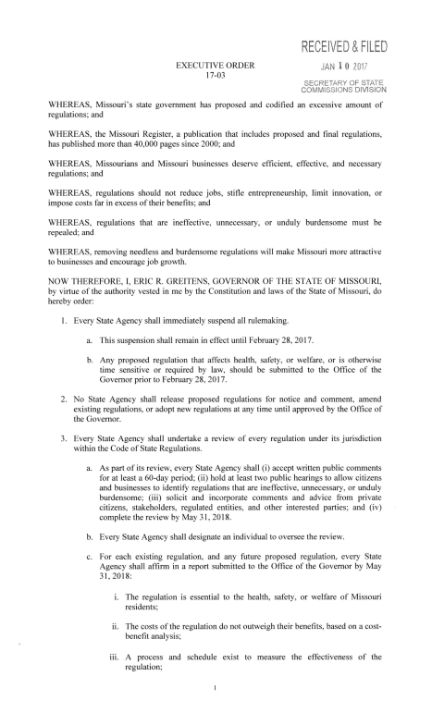
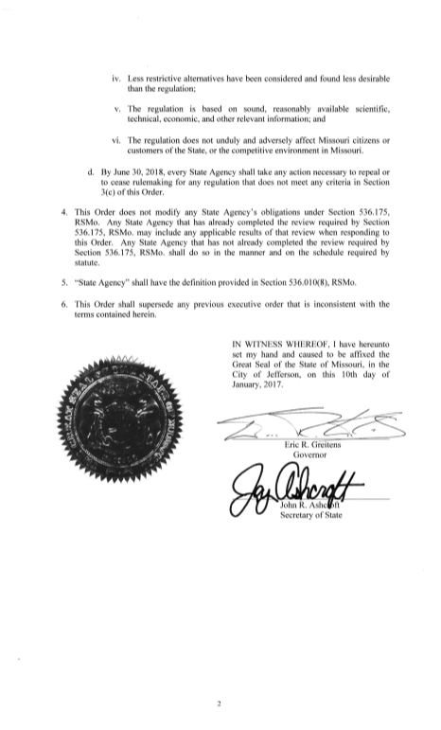
Executive order 17-03
Freeze on current rulemaking
Approval of new regulations
Review of existing regulations

Slide 14
Freeze on current rulemaking
Suspended all rulemaking during January and February 2017
Rulemaking affecting health, safety, or welfare, or that was otherwise time sensitive or required by law, could be submitted to the Governor’s office

Slide 15
Approval of New Regulations
Required Governor’s Office approval for all future rulemakings
Applies to new rules, amendments, and rescissions

Slide 16
Review of Existing Regulations
State agencies required to:
Evaluate every regulation under six criteria
Solicit public input on regulations
Prepare a report by May 31, 2018
Take necessary rulemaking action by June 30, 2018

Slide 17
Criteria to evaluate regulations
The regulation is essential to the health, safety, or welfare of Missouri residents;
The costs of the regulation do not outweigh their benefits, based on a cost benefit analysis;
A process and schedule exist to measure the effectiveness of the regulation;
Less restrictive alternatives have been considered and found less desirable than the regulation;
The regulation is based on sound, reasonably available scientific, technical, economic, and other relevant information; and
The regulation does not unduly and adversely affect Missouri citizens or customers of the State, or the competitive environment in Missouri.

Slide 18

Assembled The Red Tape Cutters
Every state agency selected a Red Tape Cutter
Red Tape Cutters lead review, seek public comment, and work to eliminate unnecessary and burdensome restrictions

Slide 19

Launched website and citizen survey

Slide 20
Missouri – public comments

Slide 21
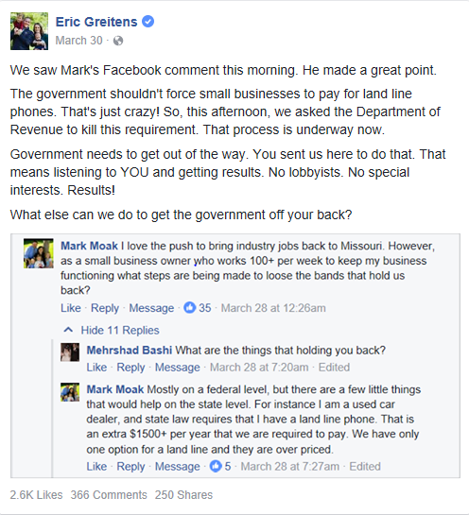
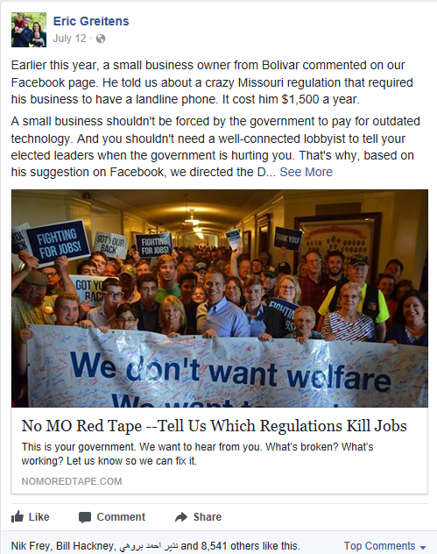
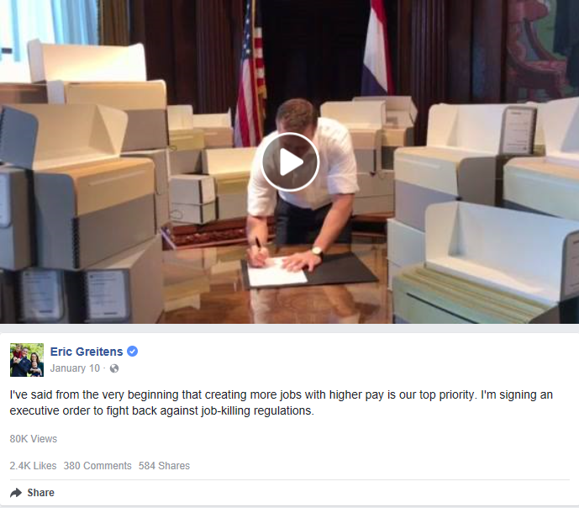
Cutting red tape

